Slide 1
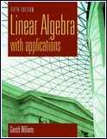
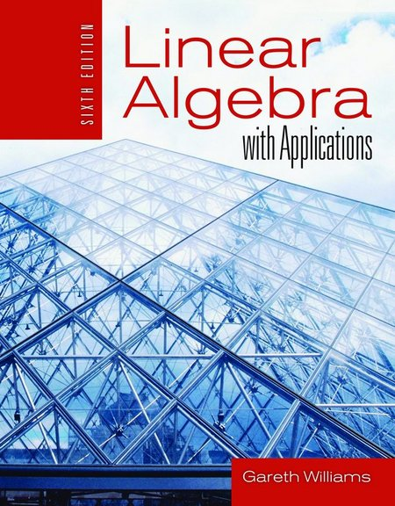
Chapter 1
Systems of Linear Equations
Linear Algebra
Math 223

Slide 2
1.1 Matrices and Systems of Linear Equations
Definition
An equation such as x+3y=9 is called a linear equation
(in two variables or unknowns).
The graph of this equation is a straight line in the xy-plane.
A pair of values of x and y that satisfy the equation is called a solution.
Ch1_<number>
Ch1_<number>

Slide 3
Definition
A linear equation in n variables x₁, x₂, x₃, …, x_{n} has the form a₁ x₁ + a₂ x₂ + a₃ x₃ + … + a_{n} x_{n} = b
where the coefficients a₁, a₂, a₃, …, a_{n} and b are real numbers.
Ch1_<number>
Ch1_<number>

Slide 4
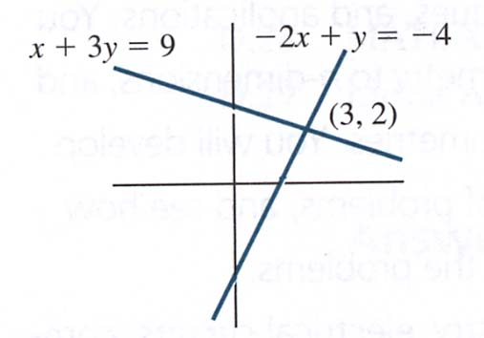
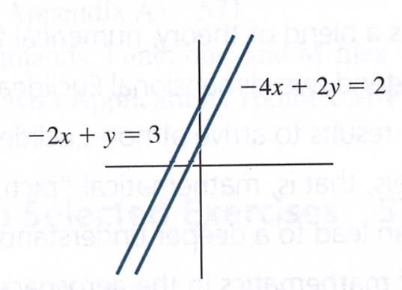
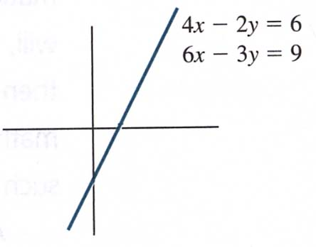
Solutions for system of linear equations
Figure 1.3
Many solution
4x – 2y = 6
6x – 3y = 9
Both equations have the same graph. Any point on the graph is a solution. Many solutions.
Figure 1.1
Unique solution
x + 3y = 9
–2x + y = –4
Lines intersect at (3, 2)
Unique solution:
x = 3, y = 2.
Figure 1.2
No solution
–2x + y = 3
–4x + 2y = 2
Lines are parallel.
No point of intersection. No solutions.
Ch1_<number>
Ch1_<number>

Slide 5
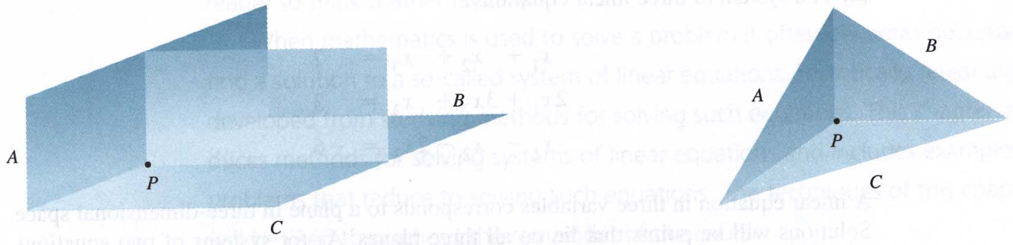
A linear equation in three variables corresponds to
a plane in three-dimensional space.
※ Systems of three linear equations in three variables:
Unique solution
Ch1_<number>
Ch1_<number>

Slide 6
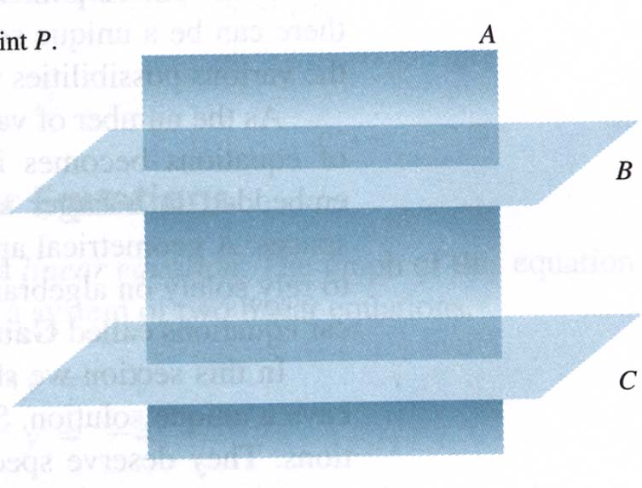
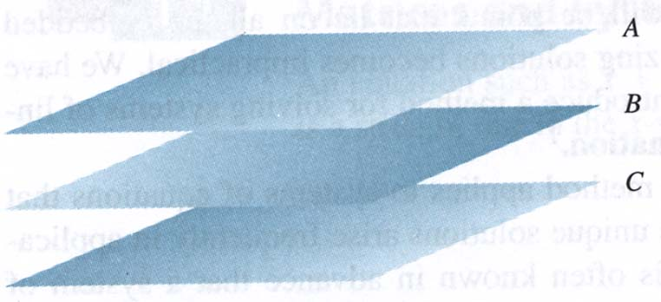
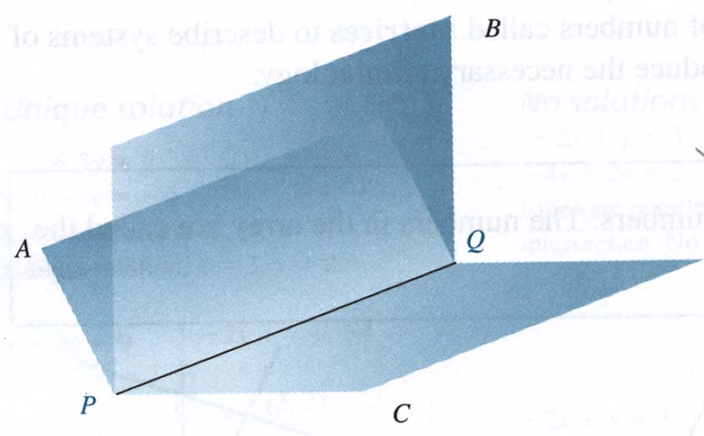
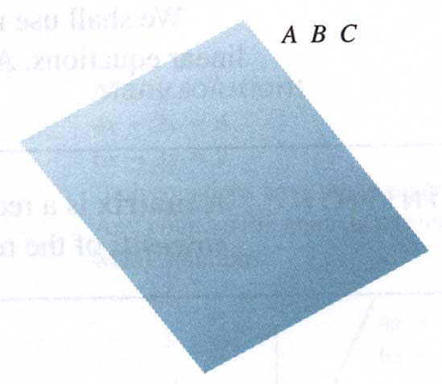
No solutions
Many solutions
Ch1_<number>
Ch1_<number>

Slide 7
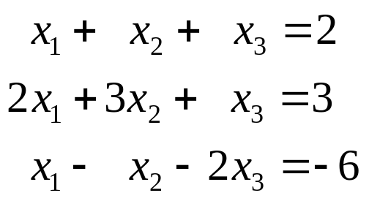
A solution to a system of a three linear equations will be points that lie on all three planes.
The following is an example of a system of three linear equations:
How to solve a system of linear equations? For this we introduce a method called Gauss-Jordan elimination. (Section1.2)
Ch1_<number>
Ch1_<number>

Slide 8
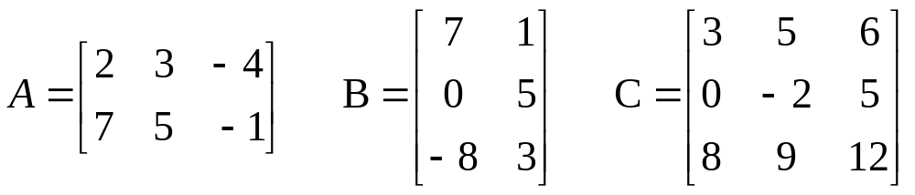
Definition
A matrix is a rectangular array of numbers.
The numbers in the array are called the elements of the matrix.
Matrices
Ch1_<number>
Ch1_<number>

Slide 9
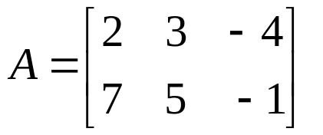
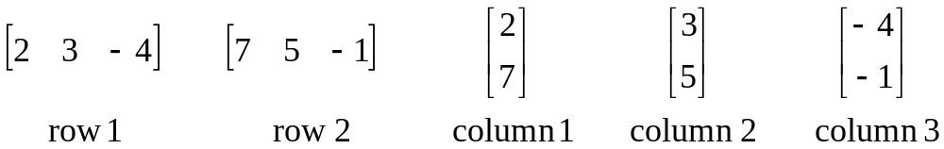
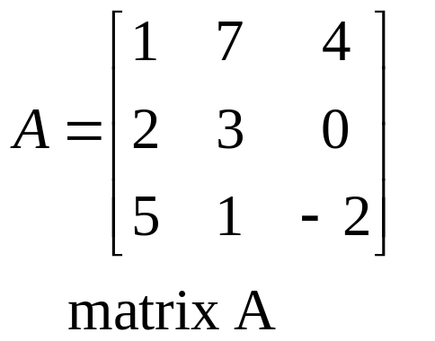
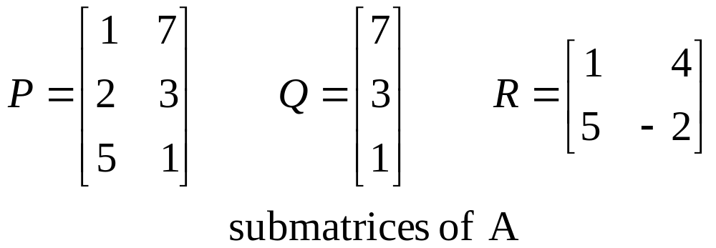
Row and Column
Submatrix
Ch1_<number>
Ch1_<number>

Slide 10
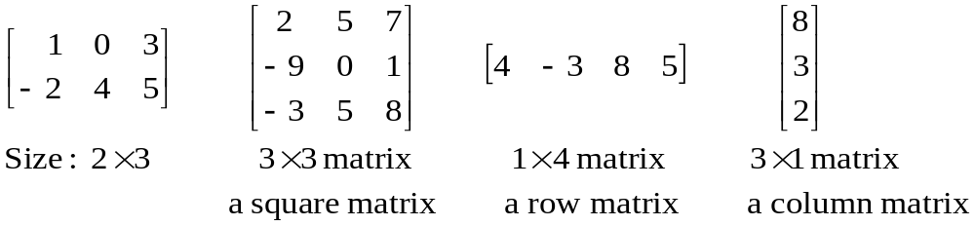
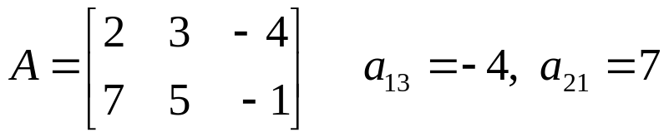
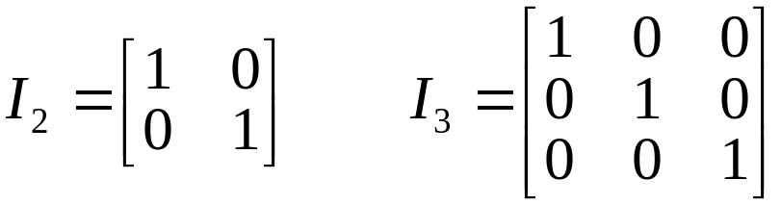
Size and Type
Location
The element a_{ij} is in row i , column j
The element in location (1,3) is −4
Identity Matrices
diagonal size
Ch1_<number>
Ch1_<number>

Slide 11
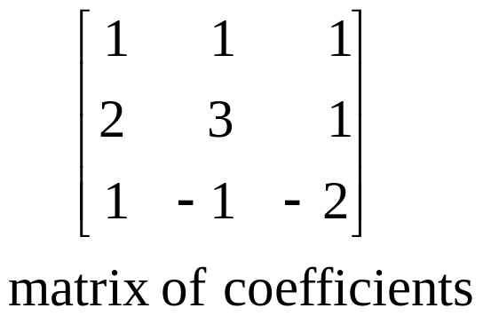
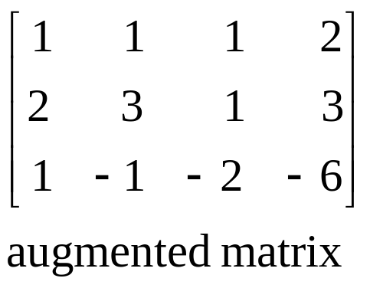
Relations between system of linear equations and matrices
matrix of coefficients and augmented matrix
Ch1_<number>
Ch1_<number>

Slide 12
Elementary Row Operations of Matrices
Elementary Transformation
Interchange two equations.
Multiply both sides of an equation by a nonzero constant.
Add a multiple of one equation to another equation.
Elementary Row Operation
Interchange two rows of a matrix.
Multiply the elements of a row by a nonzero constant.
Add a multiple of the elements of one row to the corresponding elements of another row.
Ch1_<number>
Ch1_<number>

Slide 13
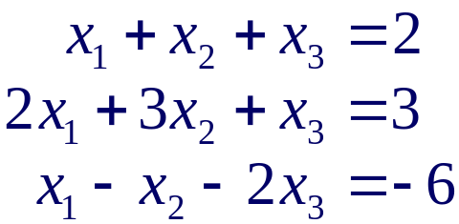
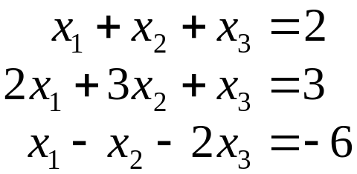
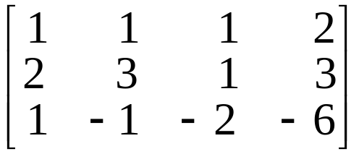
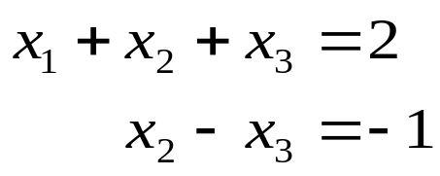
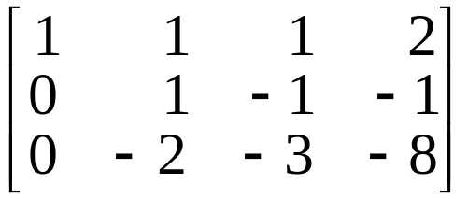

Example 1
Solving the following system of linear equation.
≈ row equivalent
Solution
Equation Method
Initial system:
Analogous Matrix Method
Augmented matrix:
Eq2+(–2)Eq1
Eq3+(–1)Eq1
≈
R2+(–2)R1
R3+(–1)R1
Ch1_<number>
Ch1_<number>

Slide 14
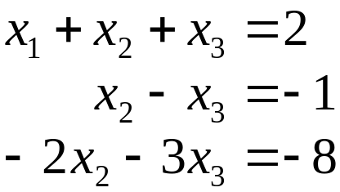
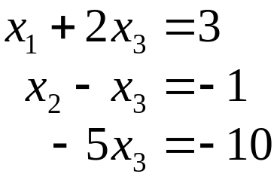
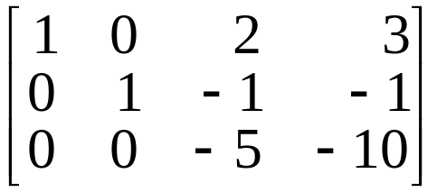
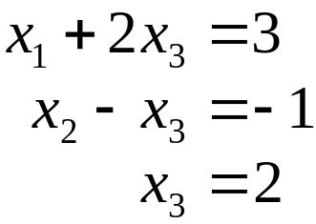
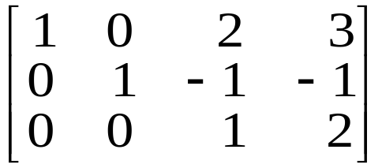
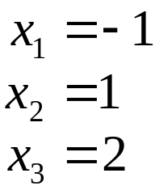
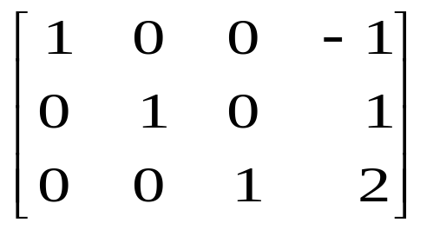

Eq1+(–1)Eq2
Eq3+(2)Eq2
≈
R1+(–1)R2
(–1/5)Eq3
R3+(2)R2
Eq1+(–2)Eq3
≈
Eq2+Eq3
(–1/5)R3
≈
R1+(–2)R3
R2+R3
The solution is
The solution is
Ch1_<number>
Ch1_<number>

Slide 15
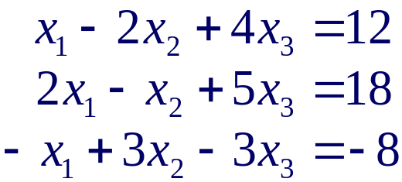
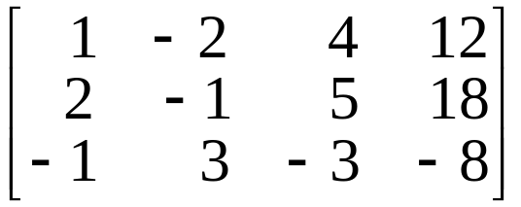
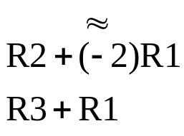
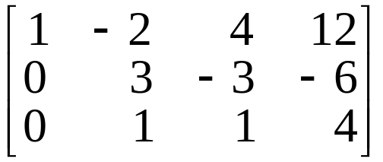
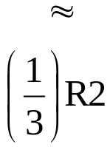
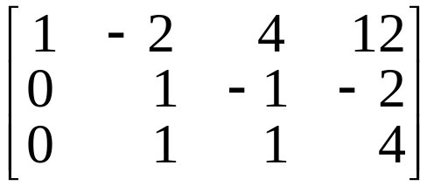
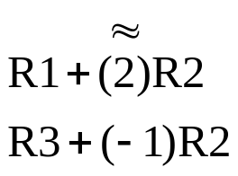
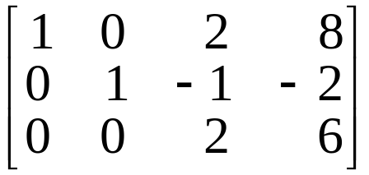
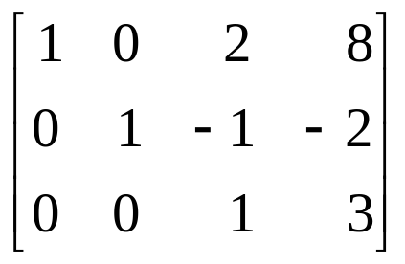
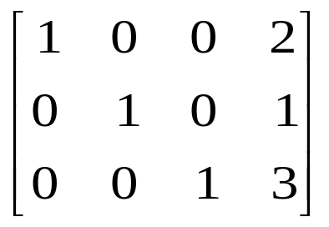
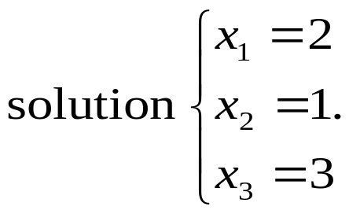
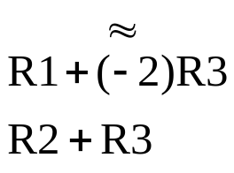
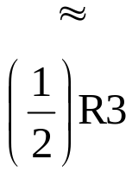
Example 2
Solving the following system of linear equation.
Solution
Ch1_<number>
Ch1_<number>

Slide 16
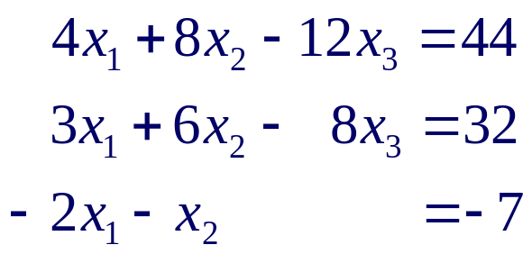
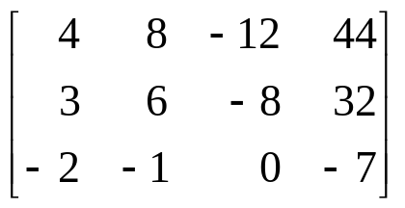
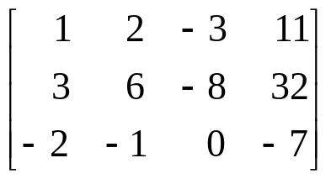
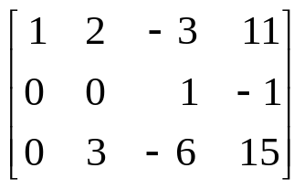










Example 3
Solve the system
Solution
Ch1_<number>
Ch1_<number>

Slide 17




Summary
Use row operations to [A: B] :
A
B
i.e.,
Def. [I_{n} : X] is called the reduced echelon form of [A : B].
Note. 1. If A is the matrix of coefficients of a system of n equations in n variables that has a unique solution,
then A is row equivalent to I_{n} (A ≈ I_{n}).
2. If A ≈ I_{n}, then the system has unique solution.
Ch1_<number>
Ch1_<number>

Slide 18









Example 4 Many Systems
Solving the following three systems of linear equation, all of which have the same matrix of coefficients.
Solution
≈
R2+(–2)R1
R3+R1
The solutions to
the three systems are
Ch1_<number>
Ch1_<number>

Slide 19
Homework
Exercise 1.1: (page 12)
1, 2, 4, 5, 6, 10, 11, 12, 13
Ch1_<number>
Ch1_<number>

Slide 20
1.2 Gauss-Jordan Elimination
Definition
A matrix is in reduced echelon form if
Any rows consisting entirely of zeros are grouped at the bottom of the matrix.
The first nonzero element of each other row is 1. This element is called a leading 1.
The leading 1 of each row after the first is positioned to the right of the leading 1 of the previous row.
All other elements in a column that contains a leading 1 are zero.
Ch1_<number>
Ch1_<number>

Slide 21

Examples for reduced echelon form
()
()
()
()
elementary row operations，reduced echelon form
The reduced echelon form of a matrix is unique.
Ch1_<number>
Ch1_<number>

Slide 22
Gauss-Jordan Elimination
System of linear equations
⇒ augmented matrix
⇒ reduced echelon form
⇒ solution
Ch1_<number>
Ch1_<number>

Slide 23







Example 1
Use the method of Gauss-Jordan elimination to find reduced echelon form of the following matrix.
Solution
pivot (leading 1)
pivot
Ch1_<number>
The matrix is the reduced echelon form of the given matrix.
Ch1_<number>

Slide 24






Example 2
Solve, if possible, the system of equations
Solution
The general solution to the system is
Ch1_<number>
Ch1_<number>

Slide 25







Example 3
Solve the system of equations
⇒ many sol.
Solution
Ch1_<number>
Ch1_<number>

Slide 26







Example 4
Solve the system of equations
Solution
Ch1_<number>
Ch1_<number>

Slide 27







Example 5
This example illustrates a system that has no solution. Let us try to solve the system
Solution
0x₁+0x₂+0x₃=1
The system has no solution.
Ch1_<number>
Ch1_<number>

Slide 28


Homogeneous System of linear Equations
Definition
A system of linear equations is said to be homogeneous if all the constant terms are zeros.
Example:
Observe that is a solution.
Theorem 1.1
A system of homogeneous linear equations in n variables always has the solution x₁ = 0, x₂ = 0. …, x_{n} = 0. This solution is called the trivial solution.
Ch1_<number>
Ch1_<number>

Slide 29


Homogeneous System of linear Equations
Note. Non trivial solution
Example:
The system has other nontrivial solutions.
Theorem 1.2
A system of homogeneous linear equations that has more variables than equations has many solutions.
Ch1_<number>
Ch1_<number>

Slide 30
Homework
Exercise set 1.2: (page 21)
2, 5, 6, 7, 8, 14
Ch1_<number>
Ch1_<number>

Slide 31
1.3 Gaussian Elimination
Definition
A matrix is in echelon form if
Any rows consisting entirely of zeros are grouped at the bottom of the matrix.
The first nonzero element of each row is 1. This element is called a leading 1.
The leading 1 of each row after the first is positioned to the right of the leading 1 of the previous row.
(This implies that all the elements below a leading 1 are zero.)
Ch1_<number>

Slide 32





Example 6
Solving the following system of linear equations using the method of Gaussian elimination.
Solution
Starting with the augmented matrix, create zeros below the pivot in the first column.
At this stage, we create a zero only below the pivot.
We have arrived at the echelon form.
Echelon form
Ch1_<number>

Slide 33



The corresponding system of equation is
We get
Substituting x₄ = 2 and x₃ = −5 into the first equation,
Let x₂ = r. The system has many solutions. The solutions are
Ch1_<number>

Slide 34

Example 7
Solving the following system of linear equations using the method of Gaussian elimination, performing back substitution using matrices.
Solution
We arrive at the echelon form as in the previous example.
Echelon form
This marks the end of the forward elimination of variables from equations. We now commence the back substitution using matrices.
Ch1_<number>

Slide 35



3
2
This matrix is the reduced echelon form of the original augmented matrix. The corresponding system of equations is
Let x₂ = r. We get same solution as previously,
Ch1_<number>

